Slide 1
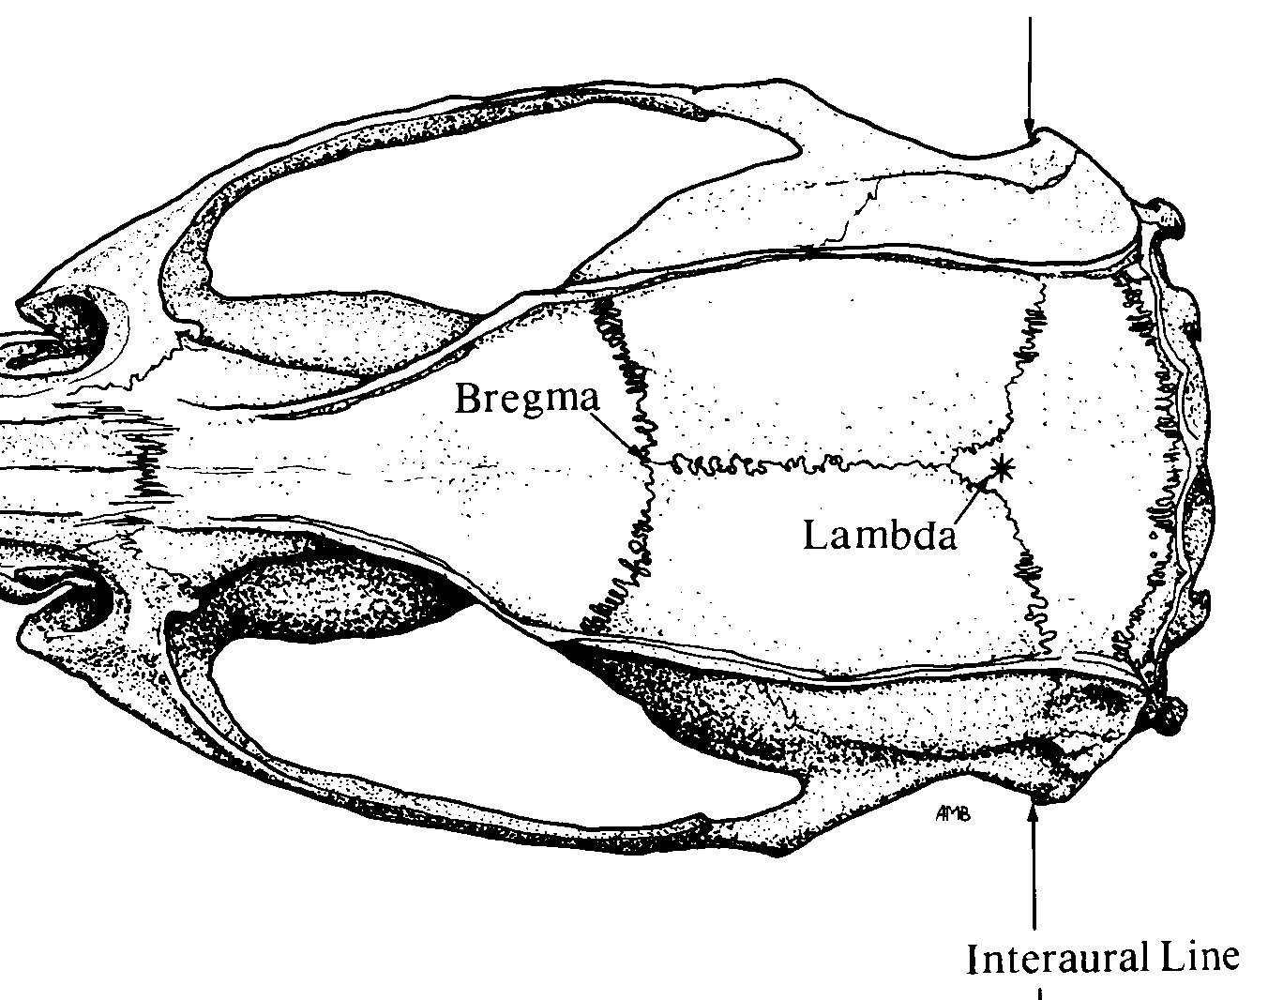
Pinnacle 3-Channel layout
Implant Map
Pin-out
1 GND | 2 EEG2 (GUIDE) | 3 EEG3 (EMG)
4 COMM | 5 EEG1 (RFC) | 6 EEG3 (EMG)
White out
*
*
2
Bregma
5
Stereotaxic Coordinates
Location | A/P | M/L | D/V
Guide cannula | +1.7 (anterior) | ±2.0 (lateral) | -3.25
Right Frontal | +0.0 | +2.0 (lateral, right only) | -0.5
EMG | Nuchal musc
Lambda
❹
❶
6
Nuchal muscle
*
Anchor screw
Ref: Selective optical drive of thalamic reticular nucleus generates thalamic bursts and cortical spindles

